Slide 1

Objects and DOM
Objects and JSON. Documet Object Model
SoftUni Team
Technical Trainers
Software University
http://softuni.bg

Slide 2
Table of Content
Objects
JSON
What is DOM?
DOM Methods
DOM Manipulations
DOM Events

Slide 3
Have a Question?
sli.do
#js-core

Slide 4
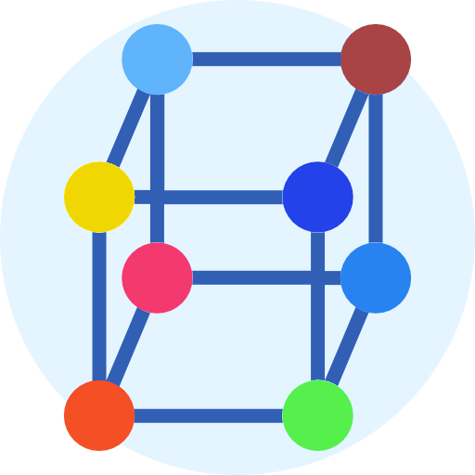
Objects
Collection of key-value pairs

Slide 5
What is an Object?
We have already learned that JavaScript variables are containers for data values
This code assigns a simple value to a variable:
Objects can contain many values
This code assigns many values (Fiat, 500, white) to a variable named car:
let car = "Fiat";
let car = {type:"Fiat", model:"500", color:"white"};

Slide 6

Defining an Object
You define (and create) a JavaScript object with an object literal:
Spaces and line breaks are not important. An object definition can span multiple lines:
let person = {firstName:"John", lastName:"Doe", age:50};
let person = {
firstName:"John",
lastName:"Doe",
age:50
};

Slide 7
Object Properties
The name:values pairs in JavaScript objects are called properties:
You can access object properties in two ways:
Property | Property Value
firstName | John
lastName | Doe
age | 50
let lastName = person.lastName; // Doe
let age = person["age"]; // 50

Slide 8
Object Methods
Objects can also have methods
Methods are actions that can be performed on objects
Methods are stored in properties as function definitions
let person = {
firstName: "John",
lastName: "Doe",
fullName: function() {
return this.firstName + " " + this.lastName;
}
};

Slide 9

{ }
JSON
JavaScript Object Notation

Slide 10
What is a JSON?
Stands for JavaScript Object Notation
It's a lightweight data interchange format
It's language independent - syntax is derived from JavaScript object notation syntax, but the JSON format is text only
Is "self-describing" and easy to understand

Slide 11
Example: JSON
This JSON syntax defines an employees object - an array of 3 employee records (objects):
{
"employees":[
{"firstName":"John", "lastName":"Doe"},
{"firstName":"Anna", "lastName":"Smith"},
{"firstName":"Peter", "lastName":"Jones"}
]
}

Slide 12

Syntax Rules
In JSON:
Data is in name/value pairs
Data is separated by commas
Curly braces hold objects
Square brackets hold arrays
{
"employees":[{"firstName":"John" , "lastName":"Doe"}]
}

Slide 13
Parsing from Strings
A common use of JSON is to read data from a web server, and display the data in a web page
For simplicity, this can be demonstrated using a string as input
Then, use the JavaScript built-in function JSON.parse() to convert the string into a JavaScript object:
let text = '{ "employees" : [' +
'{ "firstName":"John" , "lastName":"Doe" },' +
'{ "firstName":"Peter" , "lastName":"Jones" } ]}';
var obj = JSON.parse(text);

Slide 14
Parsing from Strings (2)
Finally, use the new JavaScript object in your page:
<p id="demo"></p>
<script>
document.getElementById("demo").innerHTML =
obj.employees[1].firstName + " " + obj.employees[1].lastName;
</script>

Slide 15
Converting to String
Use JSON.stringify() to convert objects into a string:
You can do the same for arrays
let obj = { name: "John", age: 30, city: "New York" };
let myJSON = JSON.stringify(obj);
console.log(myJSON)
// {"name":"John","age":30,"city":"New York"}
let arr = [ "John", "Peter", "Sally", "Jane" ];
let myJSON = JSON.stringify(arr);
console.log(myJSON)
// ["John","Peter","Sally","Jane"]

Slide 16

Document Object Model (DOM)
Document with a logical tree

Slide 17
What is DOM?
DOM is a programming API for HTML and XML documents
It defines the logical structure of the documents and the way a document is accessed and manipulated
It represents the page so that programs can change the document (structure, style and content)

Slide 18

What is DOM?
With JavaScript you can:
Change all HTML elements, attributes and styles in the page
Add and remove HTML elements and attributes
Create a HTML events and react to all of them in the page

Slide 19

Document Object Model
The DOM represents the document as nodes and objects
That way, the programming languages can connect to the page
DOM is a standard of how to:
Get HTML element
Change HTML element
Add HTML element
Delete HTML element

Slide 20
HTML DOM
The HTML DOM is an Object Model for HTML. It defines:
HTML elements as objects
Properties for all HTML elements
Methods for all HTML elements
Events for all HTML elements

Slide 21
What is the HTML DOM?
Document
Root element <html>
Element: <head>
Element: <body>
Element: <title>
Attribute: "href"
Element: <a>
Element: <h1>
text: "My value"
Text: "My link"
Text: "My header"

Slide 22

DOM Methods
Changing the HTML

Slide 23
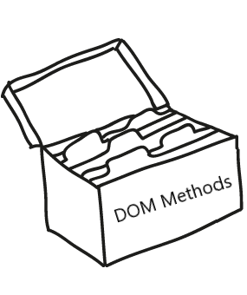
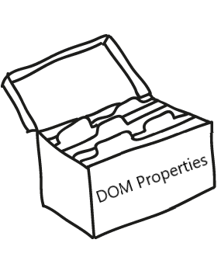
DOM Methods
DOM Methods - actions you can perform on HTML elements
DOM Properties - values of HTML elements that you can set or change

Slide 24
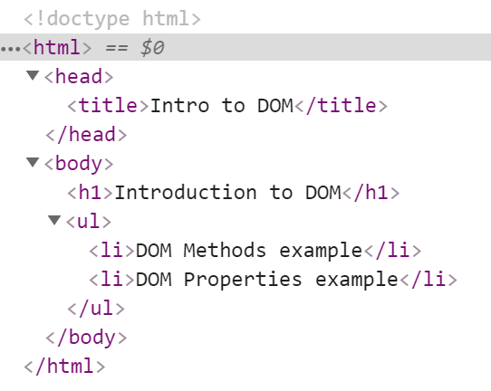



Example: DOM Methods
HTML DOM method is an action you can do (like add or delete an HTML element)

Slide 25
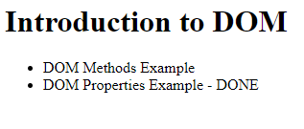
Example: DOM Methods
HTML DOM property is a value that you can get or set (changing the content of an HTML element)

Slide 26

DOM Manipulations
Modify the DOM Tree

Slide 27
DOM Manipulations
There are a few ways to find a certain HTML element in the DOM:
By id - getElementById()
By tag name - getElementsByTagName()
By class name - getElementsByClassName()
By CSS selector - querySelector()

Slide 28

DOM Manipulations
The HTML DOM allows JavaScript to change the content of HTML elements
innerHTML
attributes
setAttribute()
style.property

Slide 29

DOM Manipulations
We can create, append and remove HTML elements dynamically
removeChild()
appendChild()
replaceChild()
document.write()

Slide 30
Problem: Articles List
Write a program, which:
Creates articles and append them into the articles list

Slide 31
Solution: Articles List
function createArticle(){
let title = document.getElementById('createTitle').value
let text = document.getElementById('createContent').value
let articlesList = document.getElementById('articles')
if(title !== '' && text !== '') {
let article = document.createElement('article')
let h3 = document.createElement('h3')
h3.textContent = title
let p = document.createElement('p')
p.textContent = text
article.appendChild(h3)
article.appendChild(p)
articlesList.appendChild(article)
}
document.getElementById('createTitle').value = ""
document.getElementById('createContent').value = ""
}

Slide 32

DOM Events
Handling DOM Events

Slide 33
DOM Events
Events are actions or occurrences
They allow JavaScript to register different event handlers on elements
Events are normally used in combination with functions, and the function will not be executed before the event occurs
Such as when a user clicks a button

Slide 34
Problem: Growing Word
Write a program, which:
Changes the size and the color of a paragraph on every click

Slide 35
Solution: Growing Word
function growingWord() {
let p = document.querySelector('#exercise p');
let currPx = p.style.fontSize.slice(0,-2) * 2 || 2;
let blueDiv = document.getElementById('blueDiv');
let greenDiv = document.getElementById('greenDiv');
let redDiv = document.getElementById('redDiv');
let isBlue = blueDiv.getAttribute('active') === "true";
let isGreen = greenDiv.getAttribute('active') === "true";
let isRed = redDiv.getAttribute('active') === "true";
// Continue on the next slide...

Slide 36
Solution: Growing Word (2)
if(currPx === 2 || isBlue){
p.style.color = "blue";
blueDiv.setAttribute("active", false);
greenDiv.setAttribute("active", true);
} else if (isGreen) {
p.style.color = "green";
greenDiv.setAttribute('active', false);
redDiv.setAttribute('active', true);
} else if (isRed){
p.style.color = "red";
redDiv.setAttribute('active', false);
blueDiv.setAttribute("active",true);
}
p.style.fontSize = `${currPx}px`;
}

Slide 37
Summary
Objects are variables which can contain many values
JSON is a lightweight data interchange format
DOM is a programming API for HTML and XML documents
DOM Methods and Properties
DOM Manipulations
We can use events to change the behavior of the HTML
…
…
…

Slide 38
https://softuni.bg/courses/js-essentials

Slide 39












SoftUni Diamond Partners

Slide 40




SoftUni Organizational Partners

Slide 41




Trainings @ Software University (SoftUni)
Software University - High-Quality Education and Employment Opportunities
softuni.bg
Software University Foundation
http://softuni.foundation/
Software University @ Facebook
facebook.com/SoftwareUniversity
Software University Forums
forum.softuni.bg

Slide 42

License
This course (slides, examples, demos, videos, homework, etc.) is licensed under the "Creative Commons Attribution-NonCommercial-ShareAlike 4.0 International" license

